Slide 1

7th Grade Math
Unit 9, Lesson 5 Equivalent Numerical Expressions Volume 2, pg. 61

Slide 2


Benchmark
MA.7.AR.1.2
Determine whether two linear expressions are equivalent.
volume 2, pg. 61

Slide 3
Integrated Mathematical Thinking and Reasoning Standards
MA.K12.MTR.3.1 Complete tasks with mathematical fluency.
MA.K12.MTR.4.1 Engage in discussions that reflect on the mathematical thinking of self and others.
volume 2, pg. 61

Slide 4

Learning Target
I can determine if numerical expressions are equivalent.
volume 2, pg. 61

Slide 5

Warm-Up
volume 2, pg. 61

Slide 6
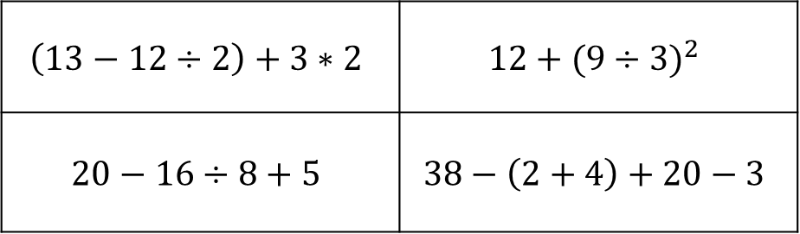
9.5.1 Warm-Up: Which One Doesn’t Belong?
Which one doesn’t belong? Justify your reasoning.
$$\left(13−12÷2\right)+3∗2$$ | $$12+{(9÷3)}^{2}$$
$$20−16÷8+5$$ | $$38−\left(2+4\right)+20−3$$
volume 2, pg. 61

Slide 7

Exploration
volume 2, pg. 62

Slide 8

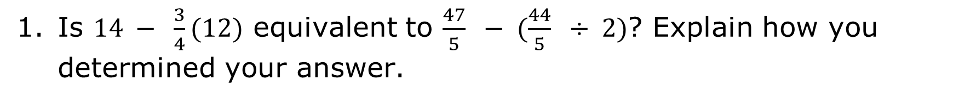
9.5.2 Exploration: Equivalent Numeric Expressions
Is $14 − \frac{3}{4}(12)$ equivalent to $\frac{47}{5} − (\frac{44}{5} ÷ 2)$? Explain how you determined your answer.
volume 2, pg. 62

Slide 9

Consider the expression $−\frac{3}{4}(12)$.
What is the value of $−\frac{3}{4}(12)$?
Explain if $−\frac{3}{4}(12)$can be rewritten as $0.75(−12)$?
volume 2, pg. 62

Slide 10

Does $\frac{−3(12)}{4}$ have the same value as the previous expressions?
Create another expression equivalent to $−\frac{3}{4}(12)$ . Share your answer with your partner.
volume 2, pg. 62

Slide 11

The expressions in the previous problem all have the same value, but they are written differently.
What do you notice as the similarities and differences between $−\frac{3}{4}(12)$, $0.75(−12)$, and $\frac{−3(12)}{4}$?
Explain which representation is easiest for you to evaluate using mental math.
volume 2, pg. 62

Slide 12

Guided Instruction
volume 2, pg. 63

Slide 13

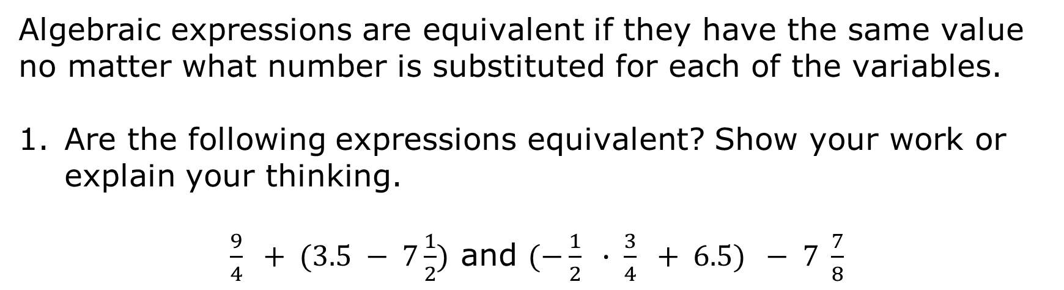
9.5.3 Guided Instruction: Equivalent Numerical Expressions
Numerical expressions are equivalent if their values, when simplified, are the same.
Algebraic expressions are equivalent if they have the same value no matter what number is substituted for each of the variables.
Are the following expressions equivalent? Show your work or explain your thinking.
$\frac{9}{4} + (3.5 − 7\frac{1}{2})$ and $(−\frac{1}{2} ∙ \frac{3}{4} + 6.5) − 7 \frac{7}{8}$
volume 2, pg. 63

Slide 14
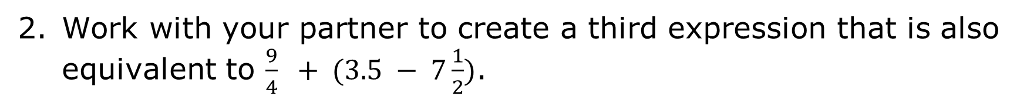
Work with your partner to create a third expression that is also equivalent to $\frac{9}{4} + (3.5 − 7\frac{1}{2})$.
volume 2, pg. 63

Slide 15

Try It
volume 2, pg. 63

Slide 16

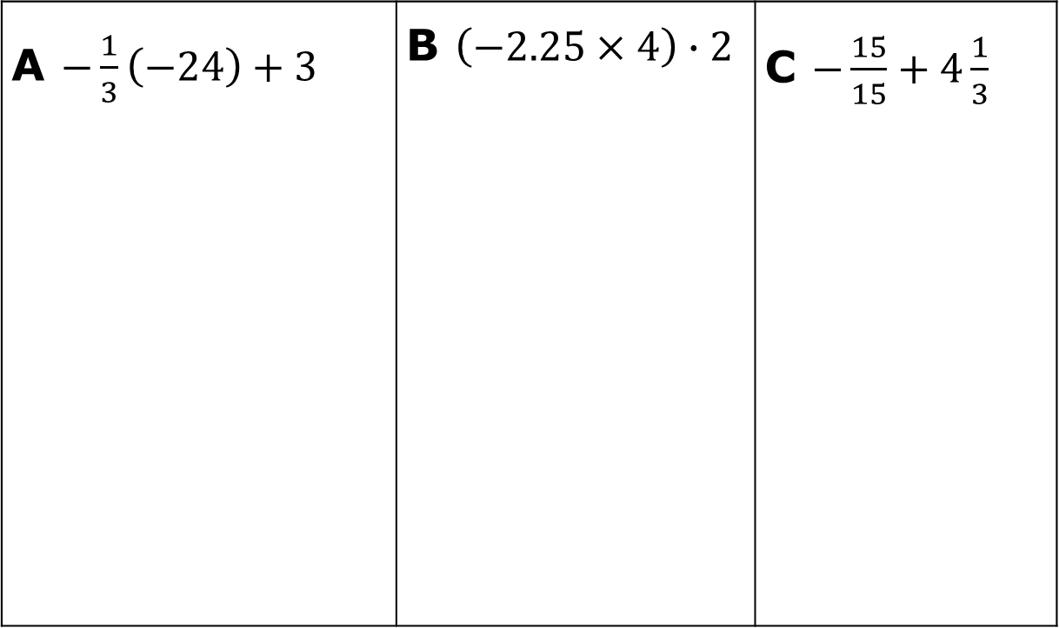
9.5.4 Try It: Equivalent Numerical Expressions
Evaluate expressions A-L.
A $−\frac{1}{3}\left(−24\right)+3$ | B $\left(−2.25×4\right)∙2$ | C $−\frac{15}{15}+4\frac{1}{3}$
volume 2, pg. 63

Slide 17
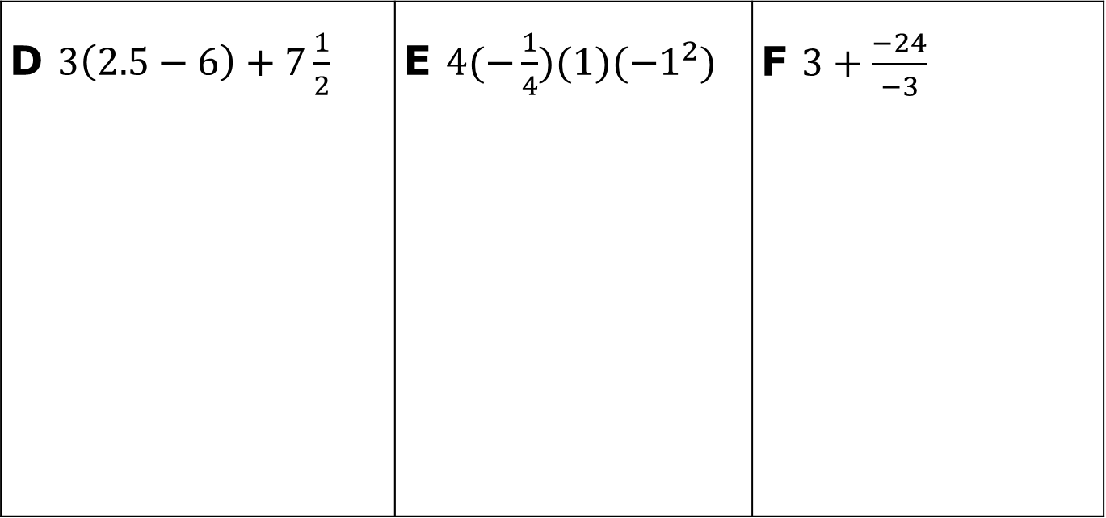
D $3\left(2.5−6\right)+7\frac{1}{2}$ | E $4(−\frac{1}{4})(1)({−1}^{2})$ | F $3+\frac{−24}{−3}$
volume 2, pg. 63

Slide 18
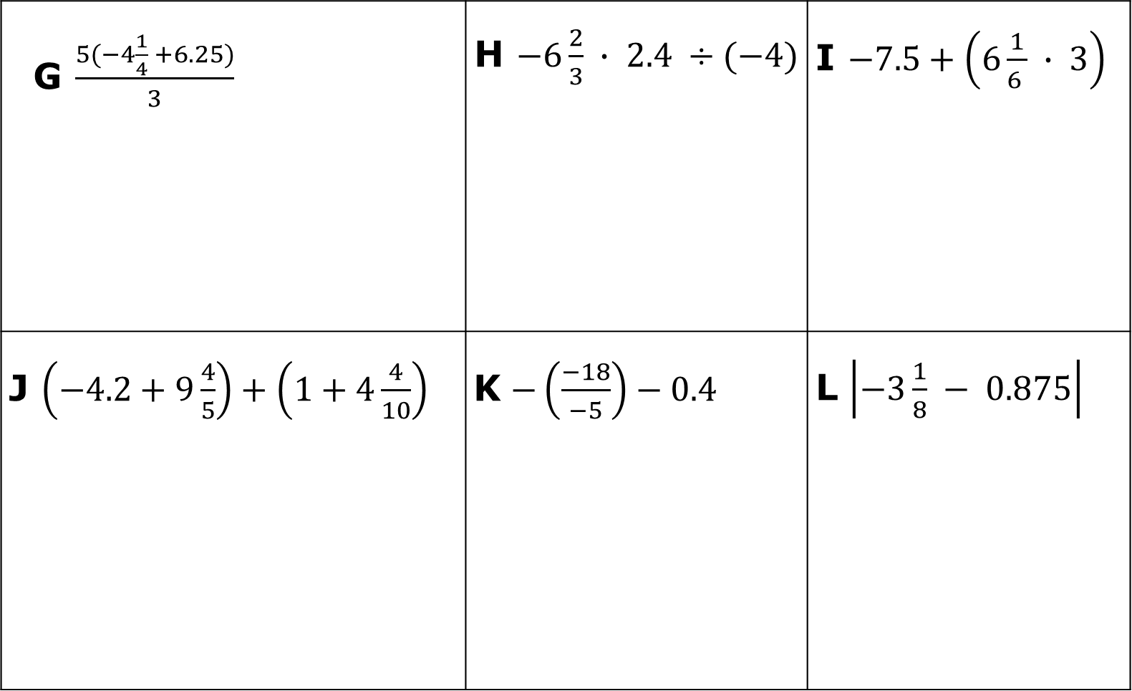
G $\frac{5(−4\frac{1}{4} +6.25)}{3}$ | H $−6\frac{2}{3} ∙ 2.4 ÷(−4)$ | I $−7.5+\left(6\frac{1}{6 } ∙ 3\right)$
J $\left(−4.2+9\frac{4}{5}\right)+\left(1+4\frac{4}{10}\right)$ | K $−\left(\frac{−18}{−5}\right)−0.4$ | L $\left|−3\frac{1}{8} − 0.875\right|$
volume 2, pg. 64

Slide 19
Sort the expressions into groups based on equivalence. Record the letters of the equivalent expressions.
Equivalent Expressions
volume 2, pg. 64

Slide 20

Collaboration
volume 2, pg. 64

Slide 21

9.5.5 Collaboration: Generating Equivalent Expressions
Work with a partner to choose a numerical value.
Individually, create a unique expression using rational numbers that equals the numerical value chosen when evaluated. Include a minimum of each of the following:
four operations
one grouping symbol
two rational numbers written as fractions
volume 2, pg. 64

Slide 22
When you are finished creating your expression, trade and check each other’s numeric expressions.
Numerical Value _________
Your Expression | Your Partner’s Expression
Are they equivalent? If not, correct any errors.
volume 2, pg. 64

Slide 23

Wrap-Up
volume 2, pg. 65

Slide 24
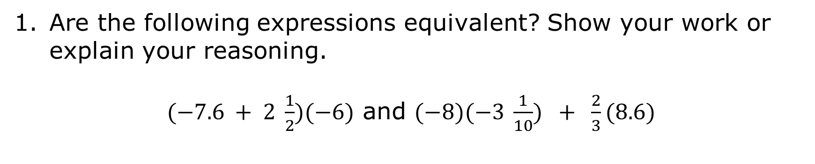
9.5.6 Wrap-Up: Cool Down
Are the following expressions equivalent? Show your work or explain your reasoning.
$(−7.6 + 2 \frac{1}{2})(−6)$ and $(−8)(−3 \frac{1}{10}) + \frac{2}{3}(8.6)$
volume 2, pg. 65

